Slide 1

Decision Tree - Bagging -Random Tree Forest
MK340 - Machine Learning
Lecture: Introduction to Machine Learning
Nirmal Pregassame

Slide 2
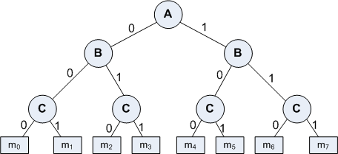
Decision Tree Concept
A Decision Tree is an important data structure known to solve many computational problems
Example 1: Binary Decision Tree

Slide 3
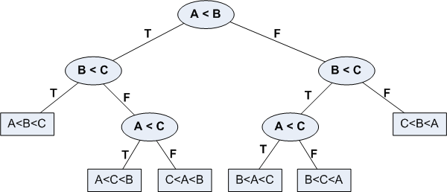
Decision Tree Concept
In Example 1, we have considered a decsion tree where values of any attribute if binary only. Decision tree is also possible where attributes are of continuous data type
Example 2: Decision Tree with numeric data

Slide 4
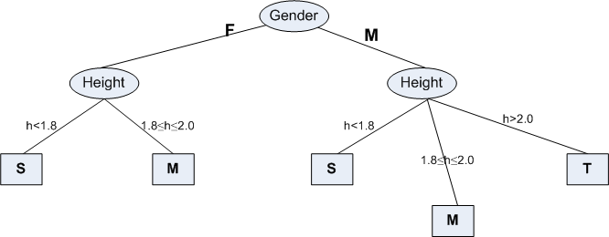
Some Characteristics of DT
There is a special node called root node.
All nodes drawn with circle (ellipse) are called internal nodes.
Nodes represents variables/parameters from the datasets.
All nodes drawn with rectangle boxes are called terminal nodes or leaf nodes.
Edges of a node represent the outcome for a value of the node.
In a path, a node with same label is never repeated.
Decision tree is not unique, as different ordering of internal nodes (parameters) can give different decision tree.

Slide 5
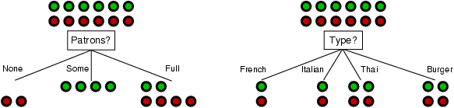
DT: Choosing an attribute
Idea: a good attribute splits the examples into subsets that are (ideally) "all positive" or "all negative"
Patrons or type?
The Greedy Search algorithm is used to optimize the homogeinity of the outputs
The output is still at 50%.

Slide 6
Challenge in DT
Problem: Decision Tree have low bias and suffer from high variance
How to reduce vaiance from a DT?
Idea:
Given set of n independant observations Z1, ..., Zn ; each with a variance V, the variance of the mean of the observations is:
V/n

Slide 7
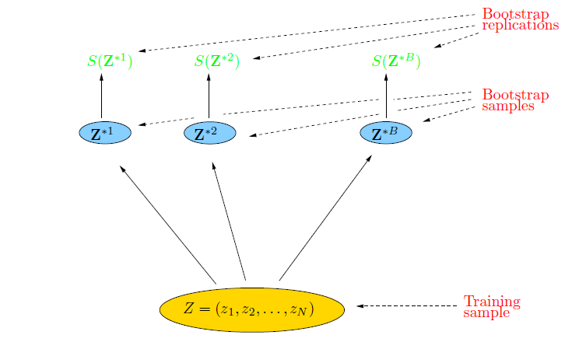
Bootstrap
The concept of Bootstrap is to randomly draw datasets with replacement from the training data, each sample the same size as the original training set

Slide 8
Bagging
The concept of bagging:
Sample M bootstrap samples.
Train M different classifiers on these bootstrap samples
For a new query, let all classifiers predict and take an average (or majority vote)
The basic idea that this works is that if the classifiers make independent errors,
then their ensemble can improve performance.
Stated differently: the variance in the prediction is reduced (we don’t suffer from
the random errors that a single classifier is bound to make).

Slide 9
Bagging in practice
Create bootstrap samples
from the training data with N elements
M features
N examples
....…

Slide 10
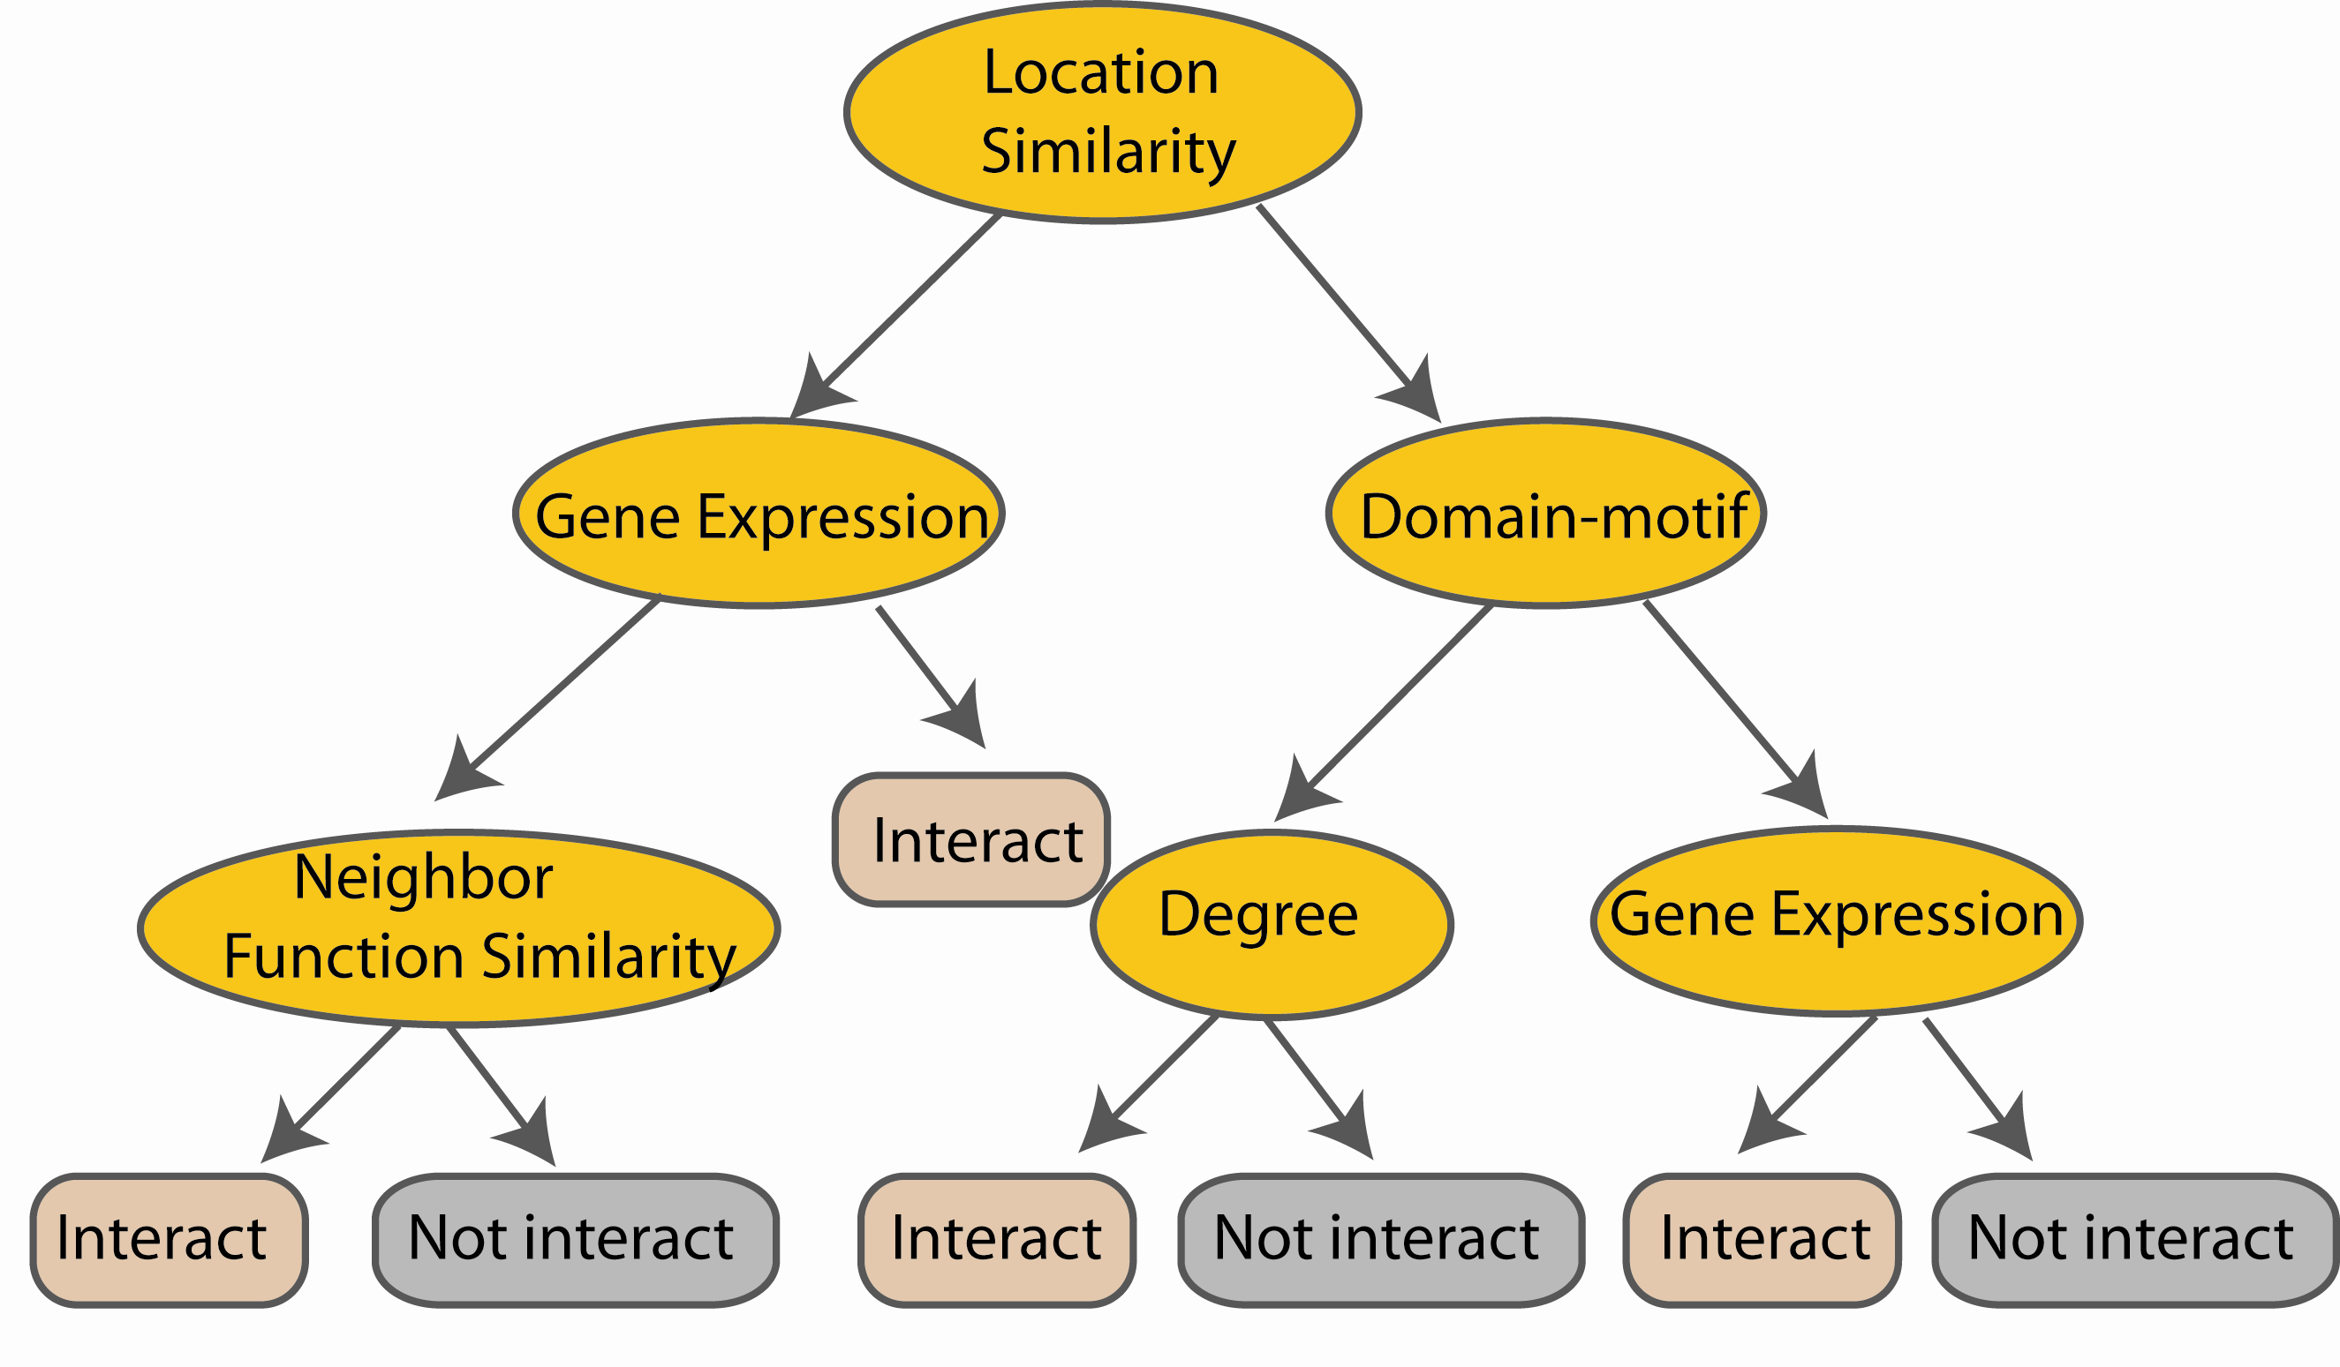
Bagging in practice
Construct a decision tree
M features
N examples
....…

Slide 11
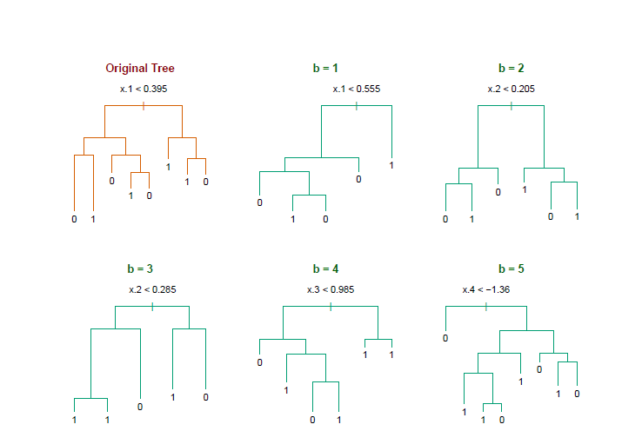
Bagging Output example
Notice the bootstrap trees are different than the original tree

Slide 12
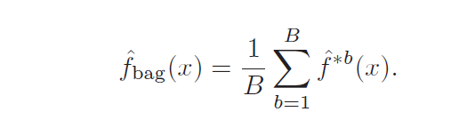
Bagging: How to make a Prediction?
Z = {(x₁, y₁), (x₂, y₂), . . . , (x_{N}, y_{N})}
Z^{*b} where = 1,.., B..
The prediction at input x
when bootstrap sample
b is used for training
http://www-stat.stanford.edu/~hastie/Papers/ESLII.pdf (Chapter 8.7)

Slide 13
Bagging in summary
Reduces overfitting (variance)
Normally uses one type of classifier (example Decision Tree)
Easy to parallelize

Slide 14
Random Forest
What is Random Forest?
An ensemble of classifier that consists of many decision trees
It uses the bagging concepts : Each DT is feeded by its own sample derivated from the original datasets
It can be used for classification or regression

Slide 15

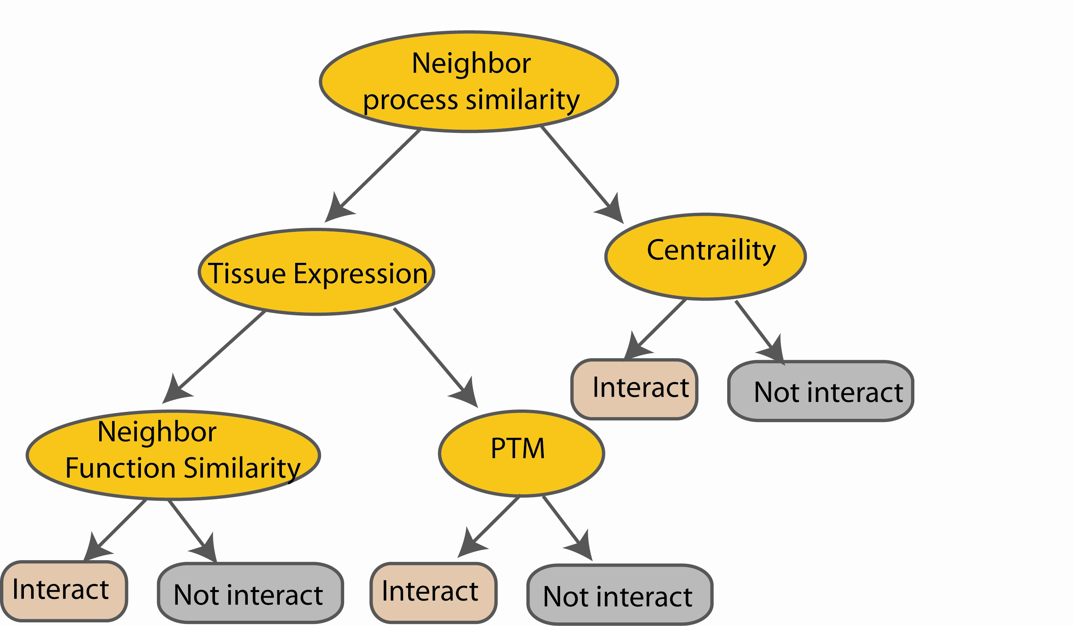
Random Forest Classifier
M features
N examples
Take the majority vote
....…
....…
Notes:
Finally the given an input data the decision is made as follows given an input data,

Slide 16
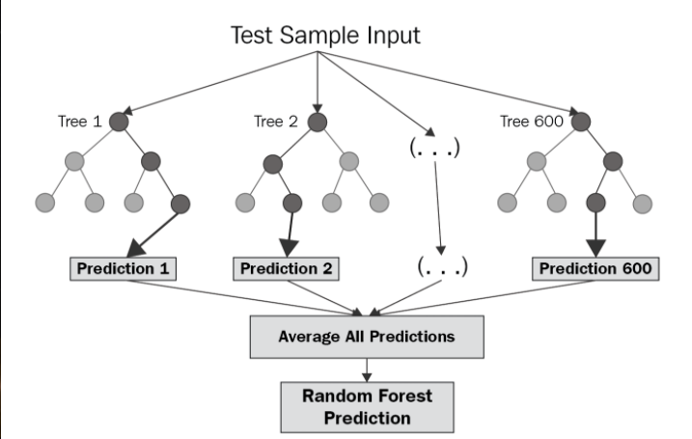
Random Forest for Regression

Slide 17
Out-of-Bag Error Estimation
No cross validation?
Remember, in bootstrapping we sample with replacement, and therefore not all observations are used for each bootstrap sample. On average 1/3 of them are not used!
We call them out-of-bag samples (OOB)
We can predict the response for the i-th observation using each of the trees in which that observation was OOB and do this for n observations
Calculate overall OOB MSE or classification error
Notes:
equivalent to leave-one-out cross-validation error
1/N to choose, 1-1/N not to choose, (1-1/N)N and (1-1/N) 1-(1-1/N)N 1-e^(-1)

